Slide 1


Market Segmentation
Brijendra Saroj

Slide 2
Marketing is crucial for the growth and sustainability of any business.
Marketers can help build the company’s brand, engage customers, grow revenue, and increase sales.
EDUCATION
(Marketers educate and communicate value proposition to customers)
ENGAGEMENT
(Marketers engage customers and understand their needs)
DRIVE SALES
(Marketers drive sales and traffic to products/services)
GROWTH
(Marketers empower business growth by reaching new customers)

Slide 3
One of the key pain points for marketers is to know their customers and identify their needs.
By understanding the customer, marketers can launch a targeted marketing campaign that is tailored for specific needs.
If data about the customers is available, data science can be applied to perform market segmentation.

Slide 4
In this case study, you have been hired as a consultant to a bank in New York City.
The bank has extensive data on their customers for the past 6 months.
The marketing team at the bank wants to launch a targeted ad marketing campaign by dividing their customers into at least 3 distinctive groups.

Slide 5
CUSTID: Identification of Credit Card holder
BALANCE: Balance amount left in customer's account to make purchases
BALANCE_FREQUENCY: How frequently the Balance is updated, score between 0 and 1 (1 = frequently updated, 0 = not frequently updated)
PURCHASES: Amount of purchases made from account
ONEOFFPURCHASES: Maximum purchase amount done in one-go
INSTALLMENTS_PURCHASES: Amount of purchase done in installment
CASH_ADVANCE: Cash in advance given by the user
PURCHASES_FREQUENCY: How frequently the Purchases are being made, score between 0 and 1 (1 = frequently purchased, 0 = not frequently purchased)

Slide 6
PURCHASES_FREQUENCY: How frequently the Purchases are being made, score between 0 and 1 (1 = frequently purchased, 0 = not frequently purchased)
ONEOFF_PURCHASES_FREQUENCY: How frequently Purchases are happening in one-go (1 = frequently purchased, 0 = not frequently purchased)
PURCHASES_INSTALLMENTS_FREQUENCY: How frequently purchases in installments are being done (1 = frequently done, 0 = not frequently done)
CASH_ADVANCE_FREQUENCY: How frequently the cash in advance being paid

Slide 7
CASH_ADVANCE_TRX: Number of Transactions made with "Cash in Advance“
PURCHASES_TRX: Number of purchase transactions made
CREDIT_LIMIT: Limit of Credit Card for user
PAYMENTS: Amount of Payment done by user
MINIMUM_PAYMENTS: Minimum amount of payments made by user
PRC_FULL_PAYMENT: Percent of full payment paid by user
TENURE: Tenure of credit card service for user

Slide 8
STEPS
IMPORT LIBRARIES AND DATASETS
import pandas as pd
import numpy as np
import seaborn as sns
import matplotlib.pyplot as plt
from sklearn.preprocessing import StandardScaler, normalize
from sklearn.cluster import KMeans
from sklearn.decomposition import PCA

Slide 9
STEPS
Data Analysis
Info()
Describe ()
Check who made one off purchase of approx. $40761
Who made cash advance of $47000 and $48000

Slide 10
STEPS
VISUALIZE AND EXPLORE DATASET
Check for Null Values
Fill up the missing elements with mean of the 'MINIMUM_PAYMENT’
Fill up the missing elements with mean of the 'CREDIT_LIMIT’
Check for Null Values – again
Check duplicated entries in the data
Drop Customer ID since it has no meaning here

Slide 11
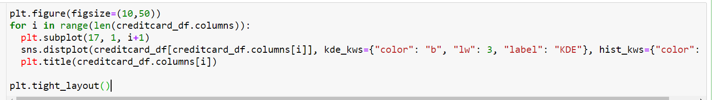
STEPS
Create a list with number of columns
Create a KDE plot with all the columns – create with for loop , iterate through all the columns in the list

Slide 12
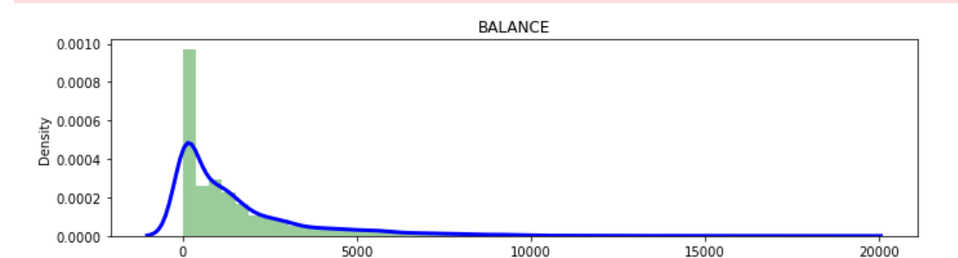
STEPS

Slide 13
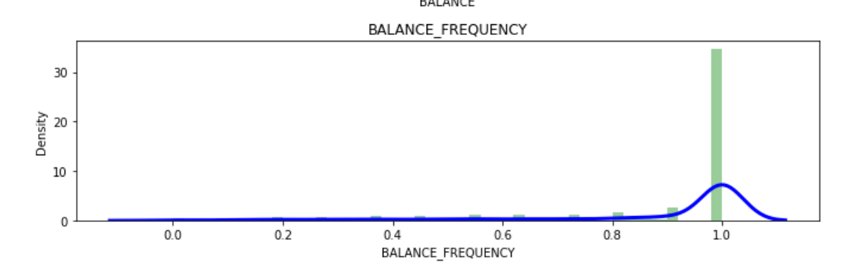
STEPS

Slide 14
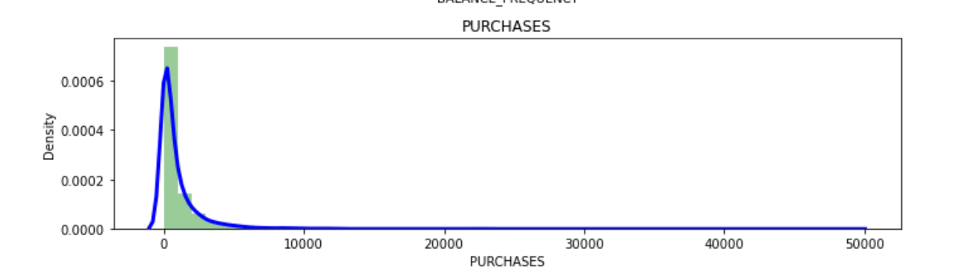
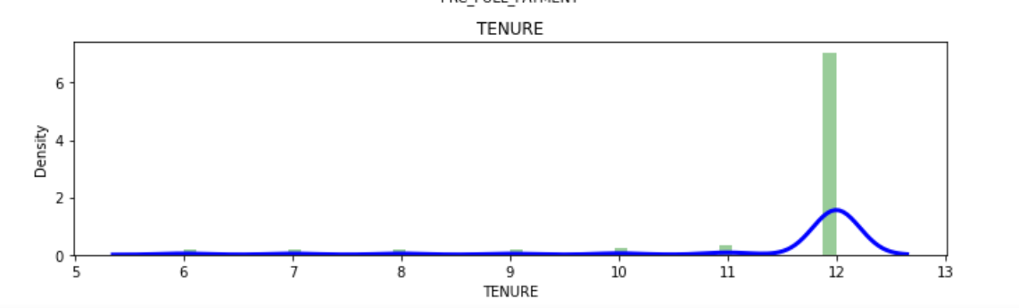
STEPS

Slide 15
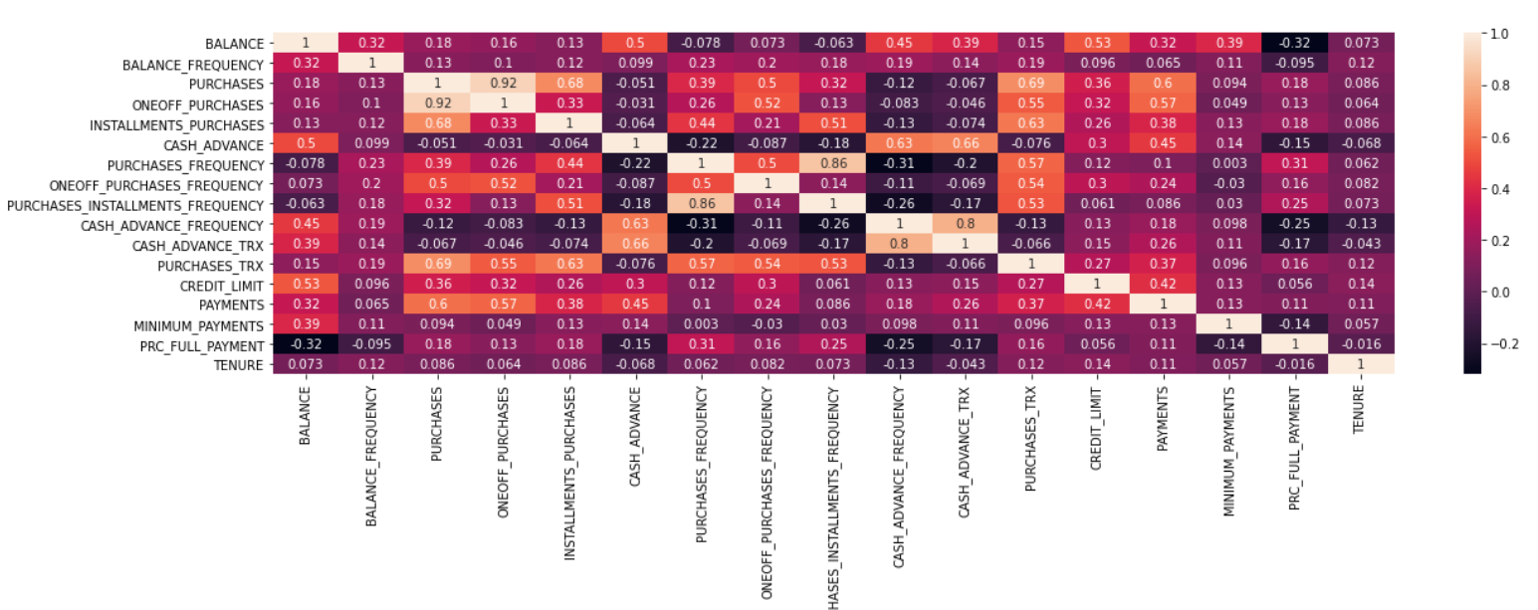
STEPS
Create Heat Map

Slide 16
STEPS
Apply Feature Scaling .
Identify the Optimum number of clusters ( Elbow method)
Create the K Means Clustering Algorithm
Apply PCA in the Data Set and create clusters

